Slide 1
Introduction to Strings in Java
Unit-3

Slide 2
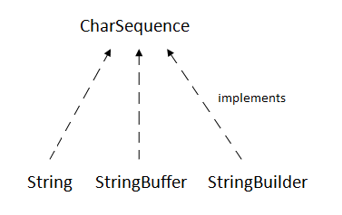
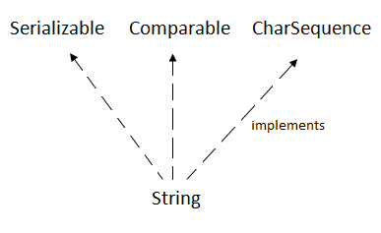
Strings
String is a sequence of characters. But in Java, string is an object that represents a sequence of characters.
The java.lang.String class is used to create a string object.
The Java String is immutable which means it cannot be changed. Whenever we change any string, a new instance is created. For mutable strings, you can use StringBuffer and StringBuilder classes.

Slide 3
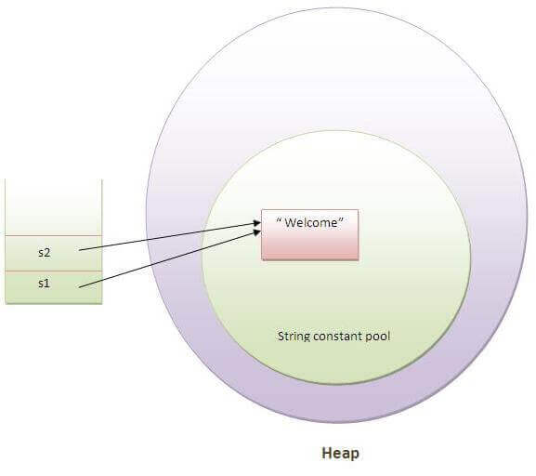
There are two ways to create String object:
By string literal
By new keyword
1. By string literal
Java String literal is created by using double quotes.
For Example:
String s="welcome";
Each time you create a string literal, the JVM checks the "string constant pool" first. If the string already exists in the pool, a reference to the pooled instance is returned. If the string doesn't exist in the pool, a new string instance is created and placed in the pool.
For example:
String s1="Welcome";
String s2="Welcome";//It doesn't create a new instance

Slide 4
2. By new keyword
String s=new String("Welcome");//creates two objects and one reference variable
In such case, JVM will create a new string object in normal (non-pool) heap memory, and the literal "Welcome" will be placed in the string constant pool. The variable s will refer to the object in a heap (non-pool).
public class StringExample{
public static void main(String args[]){
String s1="java";//creating string by java string literal
char ch[]={'s','t','r','i','n','g','s'};
String s2=new String(ch);//converting char array to string
String s3=new String("example");//creating java string by new keyword
System.out.println(s1);
System.out.println(s2);
System.out.println(s3);
}}

Slide 5
No. | Method | Description
1 | char charAt(int index) | returns char value for the particular index
2 | int length() | returns string length
3 | static String format(String format, Object... args) | returns a formatted string.
4 | static String format(Locale l, String format, Object... args) | returns formatted string with given locale.
5 | String substring(int beginIndex) | returns substring for given begin index.
6 | String substring(int beginIndex, int endIndex) | returns substring for given begin index and end index.
7 | boolean contains(CharSequence s) | returns true or false after matching the sequence of char value.
8 | static String join(CharSequence delimiter, CharSequence... elements) | returns a joined string.
9 | static String join(CharSequence delimiter, Iterable<? extends CharSequence> elements) | returns a joined string.
10 | boolean equals(Object another) | checks the equality of string with the given object.
11 | boolean isEmpty() | checks if string is empty.
12 | String concat(String str) | concatenates the specified string.
13 | String replace(char old, char new) | replaces all occurrences of the specified char value.
14 | String replace(CharSequence old, CharSequence new) | replaces all occurrences of the specified CharSequence.
15 | static String equalsIgnoreCase(String another) | compares another string. It doesn't check case.

Slide 6
16 | String[] split(String regex) | returns a split string matching regex.
17 | String[] split(String regex, int limit) | returns a split string matching regex and limit.
18 | String intern() | returns an interned string.
19 | int indexOf(int ch) | returns the specified char value index.
20 | int indexOf(int ch, int fromIndex) | returns the specified char value index starting with given index.
21 | int indexOf(String substring) | returns the specified substring index.
22 | int indexOf(String substring, int fromIndex) | returns the specified substring index starting with given index.
23 | String toLowerCase() | returns a string in lowercase.
24 | String toLowerCase(Locale l) | returns a string in lowercase using specified locale.
25 | String toUpperCase() | returns a string in uppercase.
26 | String toUpperCase(Locale l) | returns a string in uppercase using specified locale.
27 | String trim() | removes beginning and ending spaces of this string.
28 | static String valueOf(int value) | converts given type into string. It is an overloaded method.

Slide 7
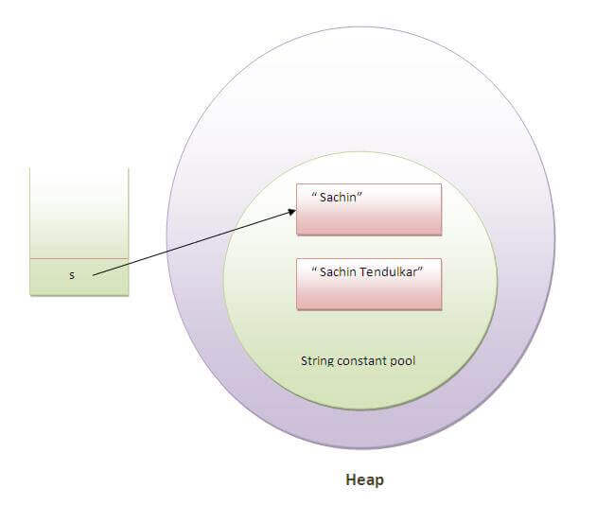
string objects are immutable
In java, string objects are immutable. Immutable simply means unmodifiable or unchangeable.
Once string object is created its data or state can't be changed but a new string object is created.
class Testimmutablestring{
public static void main(String args[]){
String s="Sachin";
s.concat(" Tendulkar");
//concat() method appends the string at the end
System.out.println(s);
//will print Sachin because strings are immutable objects
}
}

Slide 8
compare string
We can compare string in java on the basis of content and reference.
It is used in authentication (by equals() method), sorting (by compareTo() method), reference matching (by == operator) etc.
There are three ways to compare string in java:
By equals() method
By = = operator
By compareTo() method
public boolean equals(Object another) compares this string to the specified object.
public boolean equalsIgnoreCase(String another) compares this String to another string, ignoring case.
By equals() method
class Teststringcomparison1{
public static void main(String args[]){
String s1="Sachin";
String s2="Sachin";
String s3=new String("Sachin");
String s4="Saurav";
System.out.println(s1.equals(s2));//true
System.out.println(s1.equals(s3));//true
System.out.println(s1.equals(s4));//false
}
}

Slide 9
2. String compare by == operator
class Teststringcomparison3{
public static void main(String args[]){
String s1="Sachin";
String s2="Sachin";
String s3=new String("Sachin");
System.out.println(s1==s2);//true (because both refer to same instance)
System.out.println(s1==s3);//false(because s3 refers to instance created in nonpool)
}
}

Slide 10
3. String compareTo() method
The String compareTo() method compares values lexicographically and returns an integer value that describes if first string is less than, equal to or greater than second string.
Suppose s1 and s2 are two string variables. If:
s1 == s2 :0
s1 > s2 :positive value
s1 < s2 :negative value
class Teststringcomparison4{
public static void main(String args[]){
String s1="Sachin";
String s2="Sachin";
String s3="Ratan";
System.out.println(s1.compareTo(s2));//0
System.out.println(s1.compareTo(s3));//1(because s1>s3)
System.out.println(s3.compareTo(s1));//-1(because s3 < s1 )
}
}

Slide 11
StringBuffer class
Java StringBuffer class is used to create mutable (modifiable) string. The StringBuffer class in java is same as String class except it is mutable i.e. it can be changed.
Constructor | Description
StringBuffer() | creates an empty string buffer with the initial capacity of 16.
StringBuffer(String str) | creates a string buffer with the specified string.
StringBuffer(int capacity) | creates an empty string buffer with the specified capacity as length.

Slide 12
Modifier and Type | Method | Description
public synchronized StringBuffer | append(String s) | is used to append the specified string with this string. The append() method is overloaded like append(char), append(boolean), append(int), append(float), append(double) etc.
public synchronized StringBuffer | insert(int offset, String s) | is used to insert the specified string with this string at the specified position. The insert() method is overloaded like insert(int, char), insert(int, boolean), insert(int, int), insert(int, float), insert(int, double) etc.
public synchronized StringBuffer | replace(int startIndex, int endIndex, String str) | is used to replace the string from specified startIndex and endIndex.
public synchronized StringBuffer | delete(int startIndex, int endIndex) | is used to delete the string from specified startIndex and endIndex.
public synchronized StringBuffer | reverse() | is used to reverse the string.
public int | capacity() | is used to return the current capacity.
public void | ensureCapacity(int minimumCapacity) | is used to ensure the capacity at least equal to the given minimum.
public char | charAt(int index) | is used to return the character at the specified position.
public int | length() | is used to return the length of the string i.e. total number of characters.
public String | substring(int beginIndex) | is used to return the substring from the specified beginIndex.
public String | substring(int beginIndex, int endIndex) | is used to return the substring from the specified beginIndex and endIndex.

Slide 13
StringBuilder class
Java StringBuilder class is used to create mutable (modifiable) string. The Java StringBuilder class is same as StringBuffer class except that it is non-synchronized.
Constructor | Description
StringBuilder() | creates an empty string Builder with the initial capacity of 16.
StringBuilder(String str) | creates a string Builder with the specified string.
StringBuilder(int length) | creates an empty string Builder with the specified capacity as length.

Slide 14
class StringBuilderExample{
public static void main(String args[]){
StringBuilder sb=new StringBuilder("Hello ");
sb.append("Java");//now original string is changed
System.out.println(sb);//prints Hello Java
}
}

Slide 15
StringBuffer | StringBuilder
StringBuffer is synchronized i.e. thread safe. It means two threads can't call the methods of StringBuffer simultaneously. | StringBuilder is non-synchronized i.e. not thread safe. It means two threads can call the methods of StringBuilder simultaneously.
StringBuffer is less efficient than StringBuilder. | StringBuilder is more efficient than StringBuffer.
String | StringBuffer
String class is immutable. | StringBuffer class is mutable.
String is slow and consumes more memory when you concat too many strings because every time it creates new instance. | StringBuffer is fast and consumes less memory when you cancat strings.
String class overrides the equals() method of Object class. So you can compare the contents of two strings by equals() method. | StringBuffer class doesn't override the equals() method of Object class.

Slide 16
String equalsIgnoreCase() Method Example
import java.util.ArrayList;
public class EqualsIgnoreCaseExample2 {
public static void main(String[] args) {
String str1 = "Mukesh Kumar";
ArrayList<String> list = new ArrayList<>();
list.add("Mohan");
list.add("Mukesh");
list.add("RAVI");
list.add("MuKesH kuMar");
list.add("Suresh");
for (String str : list) {
if (str.equalsIgnoreCase(str1)) {
System.out.println("Mukesh kumar is present");
}
}
}
}

Slide 17
Java String format() method example
public class FormatExample{
public static void main(String args[]){
String name="sonoo";
String sf1=String.format("name is %s",name);
String sf2=String.format("value is %f",32.33434);
String sf3=String.format("value is %32.12f",32.33434);//returns 12 char fractional part filling with 0
System.out.println(sf1);
System.out.println(sf2);
System.out.println(sf3);
}}

Slide 18
public class FormatExample3 {
public static void main(String[] args) {
String str1 = String.format("%d", 101);
String str2 = String.format("|%10d|", 101); // Specifying length of integer
String str3 = String.format("|%-10d|", 101); // Left-justifying within the specified width
String str4 = String.format("|% d|", 101);
String str5 = String.format("|%010d|", 101); // Filling with zeroes
System.out.println(str1);
System.out.println(str2);
System.out.println(str3);
System.out.println(str4);
System.out.println(str5);
}
}
101
| 101|
|101 |
| 101|
|0000000101|

Slide 19
Java String substring() Method
public class SubstringExample2 {
public static void main(String[] args) {
String s1="Javatpoint";
String substr = s1.substring(0); // Starts with 0 and goes to end
System.out.println(substr);
String substr2 = s1.substring(5,10); // Starts from 5 and goes to 10
System.out.println(substr2);
String substr3 = s1.substring(5,15); // Returns Exception
}
}

Slide 20
Java Math class provides several methods to work on math calculations like min(), max(), avg(), sin(), cos(), tan(), round(), ceil(), floor(), abs() etc.
public class JavaMathExample1
{
public static void main(String[] args)
{
double x = 28;
double y = 4;
// return the maximum of two numbers
System.out.println("Maximum number of x and y is: " +Math.max(x, y));
// return the square root of y
System.out.println("Square root of y is: " + Math.sqrt(y));
//returns 28 power of 4 i.e. 28*28*28*28
System.out.println("Power of x and y is: " + Math.pow(x, y));
// return the logarithm of given value
System.out.println("Logarithm of x is: " + Math.log(x));
System.out.println("Logarithm of y is: " + Math.log(y));
// return the logarithm of given value when base is 10
System.out.println("log10 of x is: " + Math.log10(x));
System.out.println("log10 of y is: " + Math.log10(y));
// return the log of x + 1
System.out.println("log1p of x is: " +Math.log1p(x));
// return a power of 2
System.out.println("exp of a is: " +Math.exp(x));
// return (a power of 2)-1
System.out.println("expm1 of a is: " +Math.expm1(x));
}
}

Slide 21
Java I/O (Input and Output)
Java I/O (Input and Output) is used to process the input and produce the output.
Java uses the concept of a stream to make I/O operation fast. The java.io package contains all the classes required for input and output operations.
A stream is a sequence of data. In Java, a stream is composed of bytes.
In Java, 3 streams are created for us automatically. All these streams are attached with the console.
1) System.out: standard output stream
2) System.in: standard input stream
3) System.err: standard error stream

Slide 25
FileOutputStream
Java FileOutputStream is an output stream used for writing data to a file.
If you have to write primitive values into a file, use FileOutputStream class. You can write byte-oriented as well as character-oriented data through FileOutputStream class. But, for character-oriented data, it is preferred to use FileWriter than FileOutputStream.

Slide 26
FileOutputStream class methods
Method | Description
protected void finalize() | It is used to clean up the connection with the file output stream.
void write(byte[] ary) | It is used to write ary.length bytes from the byte array to the file output stream.
void write(byte[] ary, int off, int len) | It is used to write len bytes from the byte array starting at offset off to the file output stream.
void write(int b) | It is used to write the specified byte to the file output stream.
FileChannel getChannel() | It is used to return the file channel object associated with the file output stream.
FileDescriptor getFD() | It is used to return the file descriptor associated with the stream.
void close() | It is used to closes the file output stream.

Slide 27
import java.io.FileOutputStream;
public class FileOutputStreamExample {
public static void main(String args[]){
try{
FileOutputStream fout=new FileOutputStream("D:\\testout.txt");
String s="Welcome to javaTpoint.";
byte b[]=s.getBytes();//converting string into byte array
fout.write(b);
fout.close();
System.out.println("success...");
}catch(Exception e){System.out.println(e);}
}
}

Slide 28
FileInputStream
Java FileInputStream class obtains input bytes from a file.
It is used for reading byte-oriented data (streams of raw bytes) such as image data, audio, video etc. You can also read character-stream data. But, for reading streams of characters, it is recommended to use FileReader class.

Slide 29
Method | Description
int available() | It is used to return the estimated number of bytes that can be read from the input stream.
int read() | It is used to read the byte of data from the input stream.
int read(byte[] b) | It is used to read up to b.length bytes of data from the input stream.
int read(byte[] b, int off, int len) | It is used to read up to len bytes of data from the input stream.
long skip(long x) | It is used to skip over and discards x bytes of data from the input stream.
FileChannel getChannel() | It is used to return the unique FileChannel object associated with the file input stream.
FileDescriptor getFD() | It is used to return the FileDescriptor object.
protected void finalize() | It is used to ensure that the close method is call when there is no more reference to the file input stream.
void close() | It is used to closes the stream.

Slide 30
import java.io.FileInputStream;
public class DataStreamExample {
public static void main(String args[]){
try{
FileInputStream fin=new FileInputStream("D:\\testout.txt");
int i=0;
while((i=fin.read())!=-1){
System.out.print((char)i);
}
fin.close();
}catch(Exception e){System.out.println(e);}
}
}

Slide 31
StringReader
StringReader class is a character stream with string as a source. It takes an input string and changes it into character stream. It inherits Reader class.
In StringReader class, system resources like network sockets and files are not used, therefore closing the StringReader is not necessary.

Slide 32
Method | Description
int read() | It is used to read a single character.
int read(char[] cbuf, int off, int len) | It is used to read a character into a portion of an array.
boolean ready() | It is used to tell whether the stream is ready to be read.
boolean markSupported() | It is used to tell whether the stream support mark() operation.
long skip(long ns) | It is used to skip the specified number of character in a stream
void mark(int readAheadLimit) | It is used to mark the mark the present position in a stream.
void reset() | It is used to reset the stream.
void close() | It is used to close the stream.

Slide 33
import java.io.StringReader;
public class StringReaderExample {
public static void main(String[] args) throws Exception {
String srg = "Hello Java!! \nWelcome to Javatpoint.";
StringReader reader = new StringReader(srg);
int k=0;
while((k=reader.read())!=-1){
System.out.print((char)k);
}
}
}

Slide 34
StringWriter
StringWriter class is a character stream that collects output from string buffer, which can be used to construct a string.
The StringWriter class inherits the Writer class.
In StringWriter class, system resources like network sockets and files are not used, therefore closing the StringWriter is not necessary.

Slide 35
Method | Description
void write(int c) | It is used to write the single character.
void write(String str) | It is used to write the string.
void write(String str, int off, int len) | It is used to write the portion of a string.
void write(char[] cbuf, int off, int len) | It is used to write the portion of an array of characters.
String toString() | It is used to return the buffer current value as a string.
StringBuffer getBuffer() | It is used t return the string buffer.
StringWriter append(char c) | It is used to append the specified character to the writer.
StringWriter append(CharSequence csq) | It is used to append the specified character sequence to the writer.
StringWriter append(CharSequence csq, int start, int end) | It is used to append the subsequence of specified character sequence to the writer.
void flush() | It is used to flush the stream.
void close() | It is used to close the stream.

Slide 36
import java.io.*;
public class StringWriterExample {
public static void main(String[] args) throws IOException {
char[] ary = new char[512];
StringWriter writer = new StringWriter();
FileInputStream input = null;
BufferedReader buffer = null;
input = new FileInputStream("D://testout.txt");
buffer = new BufferedReader(new InputStreamReader(input, "UTF-8"));
int x;
while ((x = buffer.read(ary)) != -1) {
writer.write(ary, 0, x);
}
System.out.println(writer.toString());
writer.close();
buffer.close();
}
}

Slide 37
Scanner class
Scanner class in Java is found in the java.util package. Java provides various ways to read input from the keyboard, the java.util.Scanner class is one of them.
The Java Scanner class breaks the input into tokens using a delimiter which is whitespace by default.
It provides many methods to read and parse various primitive values.
The Java Scanner class is widely used to parse text for strings and primitive types using a regular expression.
By the help of Scanner in Java, we can get input from the user in primitive types such as int, long, double, byte, float, short, etc
The Java Scanner class extends Object class and implements Iterator and Closeable interfaces.

Slide 38
To get the instance of Java Scanner which reads input from the user, we need to pass the input stream (System.in) in the constructor of Scanner class.
Scanner in = new Scanner(System.in);
N | Constructor | Description
1) | Scanner(File source) | It constructs a new Scanner that produces values scanned from the specified file.
2) | Scanner(File source, String charsetName) | It constructs a new Scanner that produces values scanned from the specified file.
3) | Scanner(InputStream source) | It constructs a new Scanner that produces values scanned from the specified input stream.
4) | Scanner(InputStream source, String charsetName) | It constructs a new Scanner that produces values scanned from the specified input stream.
5) | Scanner(Readable source) | It constructs a new Scanner that produces values scanned from the specified source.
6) | Scanner(String source) | It constructs a new Scanner that produces values scanned from the specified string.
7) | Scanner(ReadableByteChannel source) | It constructs a new Scanner that produces values scanned from the specified channel.
8) | Scanner(ReadableByteChannel source, String charsetName) | It constructs a new Scanner that produces values scanned from the specified channel.
9) | Scanner(Path source) | It constructs a new Scanner that produces values scanned from the specified file.
10) | Scanner(Path source, String charsetName) | It constructs a new Scanner that produces values scanned from the specified file.

Slide 39
import java.util.*;
public class ScannerExample {
public static void main(String args[]){
Scanner in = new Scanner(System.in);
System.out.print("Enter your name: ");
String name = in.nextLine();
System.out.println("Name is: " + name);
in.close();
}
}

Slide 40
import java.util.*;
public class ScannerClassExample1 {
public static void main(String args[]){
String s = "Hello, This is JavaTpoint.";
//Create scanner Object and pass string in it
Scanner scan = new Scanner(s);
//Check if the scanner has a token
System.out.println("Boolean Result: " + scan.hasNext());
//Print the string
System.out.println("String: " +scan.nextLine());
scan.close();
System.out.println("--------Enter Your Details-------- ");
Scanner in = new Scanner(System.in);
System.out.print("Enter your name: ");
String name = in.next();
System.out.println("Name: " + name);
System.out.print("Enter your age: ");
int i = in.nextInt();
System.out.println("Age: " + i);
System.out.print("Enter your salary: ");
double d = in.nextDouble();
System.out.println("Salary: " + d);
in.close();
}
}

Slide 41
import java.util.*;
public class ScannerClassExample2 {
public static void main(String args[]){
String str = "Hello/This is JavaTpoint/My name is Abhishek.";
//Create scanner with the specified String Object
Scanner scanner = new Scanner(str);
System.out.println("Boolean Result: "+scanner.hasNextBoolean());
//Change the delimiter of this scanner
scanner.useDelimiter("/");
//Printing the tokenized Strings
System.out.println("---Tokenizes String---");
while(scanner.hasNext()){
System.out.println(scanner.next());
}
//Display the new delimiter
System.out.println("Delimiter used: " +scanner.delimiter());
scanner.close();
}
}

Slide 42
Exception Handling in Java
The Exception Handling in Java is one of the powerful mechanism to handle the runtime errors so that normal flow of the application can be maintained.
In Java, an exception is an event that disrupts the normal flow of the program. It is an object which is thrown at runtime.
Exception Handling is a mechanism to handle runtime errors such as ClassNotFoundException, IOException, SQLException, RemoteException, etc.
The core advantage of exception handling is to maintain the normal flow of the application. An exception normally disrupts the normal flow of the application that is why we use exception handling.

Slide 49
There are 5 keywords which are used in handling exceptions in Java.
Keyword | Description
try | The "try" keyword is used to specify a block where we should place exception code. The try block must be followed by either catch or finally. It means, we can't use try block alone.
catch | The "catch" block is used to handle the exception. It must be preceded by try block which means we can't use catch block alone. It can be followed by finally block later.
finally | The "finally" block is used to execute the important code of the program. It is executed whether an exception is handled or not.
throw | The "throw" keyword is used to throw an exception.
throws | The "throws" keyword is used to declare exceptions. It doesn't throw an exception. It specifies that there may occur an exception in the method. I

Slide 55
Java finally block
Java finally block is a block that is used to execute important code such as closing connection, stream etc.
Java finally block is always executed whether exception is handled or not.
Java finally block follows try or catch block.
Finally block in java can be used to put "cleanup" code such as closing a file, closing connection etc.

Slide 56
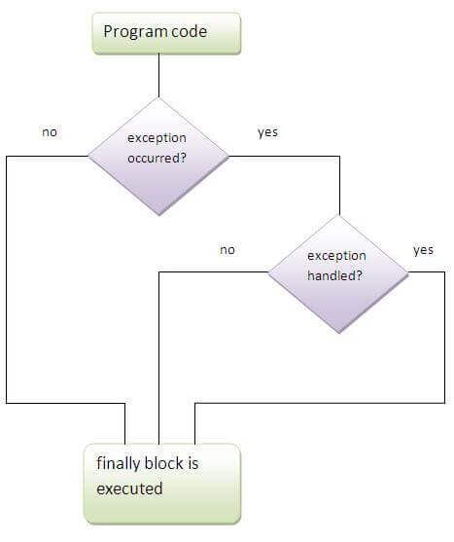

Slide 57
File Class

Slide 58
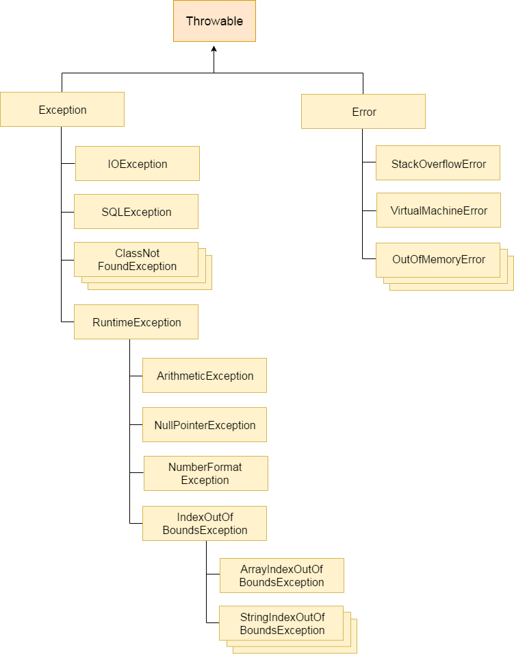
Hierarchy of Java Exception classes
Errors
Syntax errors
Runtime Errors
Logical Errors
Statements:
Normal Statements
Critical Statements

Slide 59
Java Exception Handling using a try-catch statement
public class JavaExceptionExample{
public static void main(String args[]){
try{
//code that may raise exception
int data=100/0;
}catch(ArithmeticException e){System.out.println(e);}
//rest code of the program
System.out.println("rest of the code...");
}
}

Slide 60
Problem without exception handling
public class TryCatchExample1 {
public static void main(String[] args) {
int data=50/0; //may throw exception
System.out.println("rest of the code");
}
}

Slide 61
Solution by exception handling
public class TryCatchExample2 {
public static void main(String[] args) {
try
{
int data=50/0; //may throw exception
}
//handling the exception
catch(ArithmeticException e)
{
System.out.println(e);
}
System.out.println("rest of the code");
}
}

Slide 62
public class TryCatchExample9 {
public static void main(String[] args) {
try
{
int arr[]= {1,3,5,7};
System.out.println(arr[10]); //may throw exception
}
// handling the array exception
catch(ArrayIndexOutOfBoundsException e)
{
System.out.println(e);
}
System.out.println("rest of the code");
}
}

Slide 63
resolve the exception in a catch block
public class TryCatchExample6 {
public static void main(String[] args) {
int i=50;
int j=0;
int data;
try
{
data=i/j; //may throw exception
}
// handling the exception
catch(Exception e)
{
// resolving the exception in catch block
System.out.println(i/(j+2));
}
}
}

Slide 64
Java Multi-catch block
A try block can be followed by one or more catch blocks. Each catch block must contain a different exception handler. So, if you have to perform different tasks at the occurrence of different exceptions, use java multi-catch block.
Points to remember
At a time only one exception occurs and at a time only one catch block is executed.
All catch blocks must be ordered from most specific to most general, i.e. catch for ArithmeticException must come before catch for Exception.

Slide 65
multi-catch block.
public class MultipleCatchBlock1 {
public static void main(String[] args) {
try{
int a[]=new int[5];
a[5]=30/0;
}
catch(ArithmeticException e)
{
System.out.println("Arithmetic Exception occurs");
}
catch(ArrayIndexOutOfBoundsException e)
{
System.out.println("ArrayIndexOutOfBounds Exception occurs");
}
catch(Exception e)
{
System.out.println("Parent Exception occurs");
}
System.out.println("rest of the code");
}
}

Slide 66
exception without maintaining the order of exceptions
class MultipleCatchBlock5{
public static void main(String args[]){
try{
int a[]=new int[5];
a[5]=30/0;
}
catch(Exception e){System.out.println("common task completed");}
catch(ArithmeticException e){System.out.println("task1 is completed");}
catch(ArrayIndexOutOfBoundsException e){System.out.println("task 2 completed");}
System.out.println("rest of the code...");
}
}

Slide 67
exception doesn't occur
class TestFinallyBlock{
public static void main(String args[]){
try{
int data=25/5;
System.out.println(data);
}
catch(NullPointerException e){System.out.println(e);}
finally{System.out.println("finally block is always executed");}
System.out.println("rest of the code...");
}
}

Slide 68
exception occurs and not handled.
class TestFinallyBlock1{
public static void main(String args[]){
try{
int data=25/0;
System.out.println(data);
}
catch(NullPointerException e){System.out.println(e);}
finally{System.out.println("finally block is always executed");}
System.out.println("rest of the code...");
}
}

Slide 69
Java throw keyword
The Java throw keyword is used to explicitly throw an exception.
We can throw either checked or uncheked exception in java by throw keyword.
The throw keyword is mainly used to throw custom exception.

Slide 70
public class TestThrow1{
static void validate(int age){
if(age<18)
throw new ArithmeticException("not valid");
else
System.out.println("welcome to vote");
}
public static void main(String args[]){
validate(13);
System.out.println("rest of the code...");
}
}

